Slide 1
Analyzing the Impact of Car Features on Price and Profitability Presentation
Present by: Meet Hadeeya

Slide 2
Project analysis slide 2
Description
The automotive industry has been rapidly evolving over the past few decades, with a growing focus on fuel efficiency, environmental sustainability, and technological innovation. With increasing competition among manufacturers and a changing consumer landscape, it has become more important than ever to understand the factors that drive consumer demand for cars.
In recent years, there has been a growing trend towards electric and hybrid vehicles and increased interest in alternative fuel sources such as hydrogen and natural gas. At the same time, traditional gasoline-powered cars remain dominant in the market, with varying fuel types and grades available to consumers.
Dataset: Contain more than 11,000 rows and that include different variable like (Make,Model,Year, Engine Fuel type,Engine HP, Engine Cylinders, Transmission type, Driven_Wheels, MPG,Market Category, Vehicle style,Popularity, MSRP)

Slide 3
Project analysis slide 2
Tech Stack Used
Microsoft Excel 2019 Professional Plus.
MS Excel provides plethora of functions to deal with different analysis scenarios and can easily transform the analysis into stunning visualizations with the help of charts, pivot tables etc.
Extra Tools – Data Analysis tools
Hyperlink for Excel Sheet
https://docs.google.com/spreadsheets/d/1TF2URD8lIiwi_69czSkQpytNDeYbvolD/edit?usp=sharing&ouid=112032062031627115755&rtpof=true&sd=true
Microsoft PowerPoint Presentation 2019 Professional Plus.

Slide 4
Project analysis slide 2
Approach
FEEDBACK
DATA CLEANING
6
1
PROJECT
RESULT & CONCLUSION
DATA ANALYTICS TASK
5
2
INSIGHTS
DASHBOARD MAKING
4
3

Slide 5
Project analysis slide 2
Data Cleaning
Removing rows that have null values
Column:engine fuel type,engine HP,transmission type,doors and market gatagory.
Formatting dataset

Slide 6
Project analysis slide 3
Project Analysis
TASK - 1
TASK-2
TASK-3
TASK-4
TASK-5
How does the popularity of a car model vary across different market categories?
What is the relationship between a car's engine power and its price?
Which car features are most important in determining a car's price?
How does the average price of a car vary across different manufacturers?
What is the relationship between fuel efficiency and the number of cylinders in a car's engine?

Slide 7
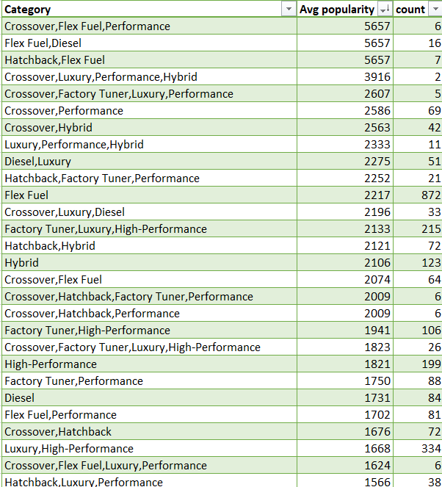
Project analysis slide 4
Task-1
A . Create a pivot table that shows the number of car models in each market category and their corresponding popularity scores.
Creating a pivot chart in MS Excel with market category, count of models in each category and average popularity for each market category
Creating combo chart with variables count of models and average popularity
Tasks
Management Objectives
Implementation lan
Schedules
Insights:
Category [Hatchback,Flex Fuel], [Flex Fuel,Diesel], [Crossover,Flex Fuel,Performance] have the highest popularity among all the other categories.
Category [Exotic, Luxury] has the lowest popularity.
Customer Objectives
Resources

Slide 8
Project analysis slide 4
Task-1
B . Create a combo chart that visualizes the relationship between market category and popularity.
Tasks
Management Objectives
Implementation lan
Schedules
Customer Objectives
Resources

Slide 9
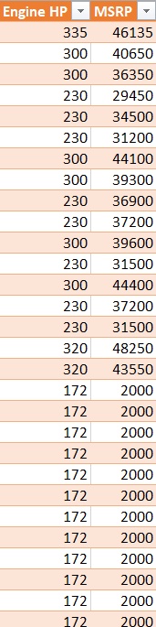
Project analysis slide 4
Task-2
Create a scatter chart that plots engine power on the x-axis and price on the y-axis. Add a trendline to the chart to visualize the relationship between these variables
Tasks
Creating a table in MS Excel with Engine HP and MSRP as columns
Creating scatter chart
Management Objectives
Implementation lan
Schedules
Resources

Slide 10
Project analysis slide 4
Task-2
Create a scatter chart that plots engine power on the x-axis and price on the y-axis. Add a trendline to the chart to visualize the relationship between these variables
Insights:
As the engine power increases the Price of the car also increses.
Tasks
Management Objectives
Implementation lan
Schedules
Customer Objectives
Resources

Slide 11
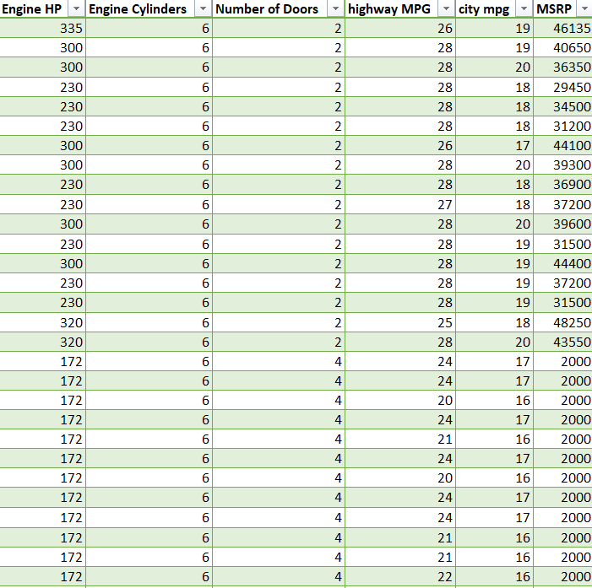
Project analysis slide 4
Task-3
Use regression analysis to identify the variables that have the strongest relationship with a car's price. Then create a bar chart that shows the coefficient values for each variable to visualize their relative importance.
Tasks
Management Objectives
Creating a table in MS Excel with Engine HP, doors, no of cylinders, highway MPG, city MPG and MSRP as columns
Regression analysis with the use of Data analysis tool add on in Excel – Price is dependent variable while other are independent variables
Creating bar chart
Implementation lan
Schedules
Resources

Slide 12
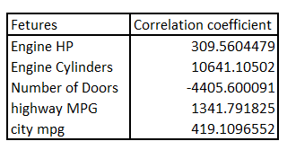
Project analysis slide 4
Task-3
Use regression analysis to identify the variables that have the strongest relationship with a car's price. Then create a bar chart that shows the coefficient values for each variable to visualize their relative importance.
Tasks
Management Objectives
Implementation lan
Schedules
No of cylinders has the highest impact on car’s price
Resources

Slide 13
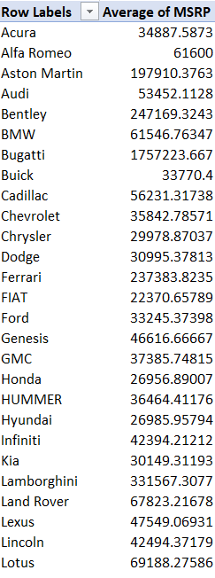
Project analysis slide 4
Task-4
A. Create a pivot table that shows the average price of cars for each manufacturer.
Tasks
Creating a pivot table in MS Excel with Car Makers and Average MSRP as columns
Creating bar chart
Management Objectives
Implementation lan
Schedules
Insights:
Buggatti has the highest average car price – premium segment position
Plymouth has the lowest average car price – Mass segment position
Resources

Slide 14
Project analysis slide 4
Task-4
B. Create a bar chart or a horizontal stacked bar chart that visualizes the relationship between manufacturer and average price.
Tasks
Management Objectives
Implementation lan
Schedules
Resources

Slide 15
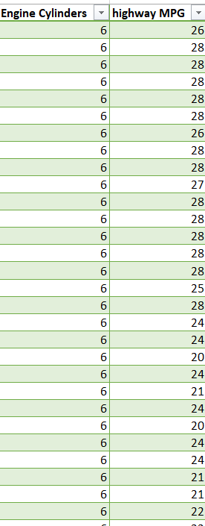
Project analysis slide 4
Task-5
A. Create a scatter plot with the number of cylinders on the x-axis and highway MPG on the y-axis. Then create a trendline on the scatter plot to visually estimate the slope of the relationship and assess its significance.
Tasks
Management Objectives
Creating a table in MS Excel with Engine cylinders and Highway MPG as columns
Creating a scattered chart with trend line
Implementation lan
Schedules
Resources

Slide 16
Project analysis slide 4
Task-5
B. Calculate the correlation coefficient between the number of cylinders and highway MPG to quantify the strength and direction of the relationship
Tasks
Insights:
As the number of cylinders increases the Fuel efficiency decreases, because of performance focused engine
Management Objectives
Implementation lan
Schedules
Look for cars with 0 cylinders, because these are electric cars and they have total range instead of miles per gallon range
Formula:
=CORREL(Engine Cylinders, Highway MPG)
Correlation Coefficient : -0.6679
Resources

Slide 17
Project analysis slide 3
Dashboard Tasks
TASK - 1
TASK-2
TASK-3
TASK-4
TASK-5
How does the distribution of car prices vary by brand and body style?
Which car brands have the highest and lowest average MSRPs, and how does this vary by body style?
How do the different feature such as transmission type affect the MSRP, and how does this vary by body style?
How does the fuel efficiency of cars vary across different body styles and model years?
How does the car's horsepower, MPG, and price vary across different Brands?

Slide 18
Project analysis slide 4
Task-1
How does the distribution of car prices vary by brand and body style?
Creating a pivot table in MS Excel with car makers in rows, Vehicle style in columns and sum of car price as values
Creating a stacked bar chart
Tasks
Management Objectives
Schedules
Insights:
Mecedes-Benz has the highest total price.
Within it Sedan vehicle style has the highest share
Oldsmobile has the lowest total price
Customer Objectives
Resources

Slide 19
Project analysis slide 4
Task-1
Tasks
Management Objectives
Implementation lan
Schedules
Customer Objectives
Resources

Slide 20
Project analysis slide 4
Task-2
Which car brands have the highest and lowest average MSRPs, and how does this vary by body style?
Creating a pivot table in MS Excel with car makers in rows, Vehicle style in columns and average of car price as values
Creating a clustered chart
Tasks
Management Objectives
Schedules
Insights:
Bugatti has the highest Average price.
Oldsmobile has the lowest average price
Customer Objectives
Resources

Slide 21
Project analysis slide 4
Task-2
Tasks
Management Objectives
Implementation lan
Schedules
Customer Objectives
Resources

Slide 22
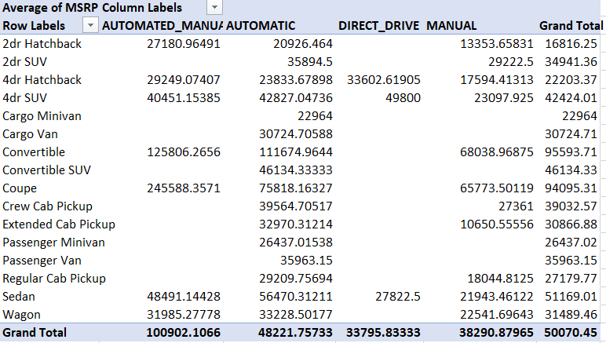
Project analysis slide 4
Task-3
How do the different feature such as transmission type affect the MSRP, and how does this vary by body style?
Creating a pivot table in MS Excel with vehicle style in rows, transmission type in columns and average of car price as values.
Creating a scatter chart with different colors for vehicle styles.
Tasks
Management Objectives
Schedules
Insights :
Automatic-manual with Coupe style has the highest avg price.
Manual with extended cab pickup style has the lowest avg price.
Resources

Slide 23
Project analysis slide 4
Task-3
Tasks
Management Objectives
Implementation lan
Schedules
Customer Objectives
Resources

Slide 24
Project analysis slide 4
Task-4
How does the fuel efficiency of cars vary across different body styles and model years?
Insights :
4dr hatchback has the highest fuel efficiency in recent years.
Cargo van and passenger vans has the lowest fuel efficiency in recent years.
Around 75% vehicle styles has either retained the same or increased fuel efficiency over the years.
Tasks
Creating a pivot table in MS Excel with model year in rows, Vehicle style in columns and average fuel efficiency as values
Creating a clustered line chart
Management Objectives
Schedules
Resources

Slide 25
Project analysis slide 4
Task-4
Tasks
Management Objectives
Implementation lan
Schedules
Customer Objectives
Resources

Slide 26
Project analysis slide 4
Task-5
How does the car's horsepower, MPG, and price vary across different Brands?
Insights :
Most of the cars belongs to below 400 Hp range and with 20 to 35 fuel efficiency range
Its smaller bubble size indicates these are low price cars targeting mass segment
Around 9 car brands lie in the 400-600 Hp range
Bugatti is the only brannd with 1000 Hp and highest avg price
Tasks
Creating a pivot table in MS Excel with Car makers in rows & avg Engine HP, avg price, avg fuel efficiency as values
Creating a Bubble chart
Management Objectives
Schedules
Resources

Slide 27
Project analysis slide 4
Task-5
Tasks
Management Objectives
Implementation lan
Schedules
Customer Objectives
Resources

Slide 28
Project analysis slide 2
Conclusion
Focus on high fuel efficiency cars attract more customers.
More cars should be manufactured in this market category [Hatchback,Flex Fuel], [Flex Fuel,Diesel], [Crossover,Flex Fuel,Performance]
Result:
This Project helped me learn more about creating combined charts and Bubble chart as a part of my data handling skills
This analysis will help car manufacturers to focus on the segment where popularity is high and including some features in every models which are highly sought by customers

Slide 29
Thank You

